Slide 1
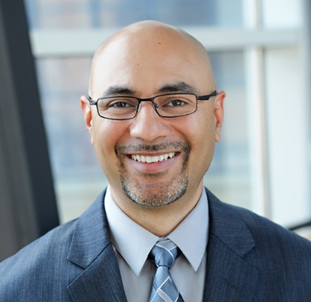
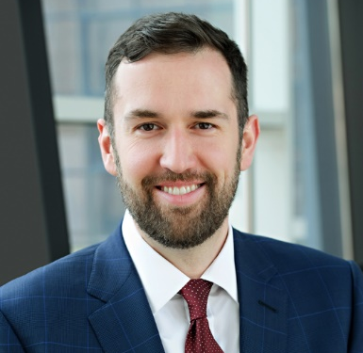
About Us
201-721-8570
www.atriade.com
mshehzad@atriade.com
rhuebsch@atriade.com
Mohammed Atif Shehzad
Managing Director
Reese Huebsch
Director, Program Development

Slide 2
Security Plan
Informed current state
Strategic path to future state
Gap and best practices awareness
Funding readiness
Executive sponsorship
Importance

Slide 3
Plan Objectives
Aligned
Synergy with business goals
Proactive
Risk focused
Intelligent
Integrated
Adaptable
User experience focused
Future state centric
Integrated with workspace
Pre-emptive
Sponsored
Efficient
Modern
Data and measurement driven
Modular and flexible
Scalable
Receptive

Slide 4
Security Plan
People Strategy
Process
Governance
Awareness
Training
Technology
Life Cycle
The 7 Elements

Slide 5
Security Plan
People Strategy

Slide 6
People Strategy: Overview
What do we mean by People Strategy?
Plan: Onboarding, growth and offboarding
Staffing Model: Requirements and Resources
Most common challenges?
Gap: Data Driven Staffing Model
Forecasting
Business Case for Resources
Elements of a good Staffing Model
Requirements
Skillsets and Roles
Engagement
Supporting Data

Slide 7
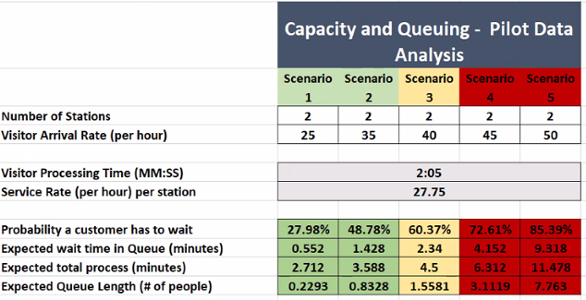
People Strategy: Staffing Model Elements
What is the purpose of the data driven staffing model?
Forecast of operations
Measures workloads in time (frequency x resolution time)
Identifies capacity in time by resources
What data do you need?
Task Inventory
Frequency of Task
Task Resolution Time
Resource Impact of Task
Capacity of Resources
Administrative time and human time
Structured Data Collection

Slide 8
People Strategy: Data Collection Process
Define Scope
Develop Inventory
Collect Data
Identify Data Sources
Value
Forecasting
Capture Challenges
Task Data
Criticality
Resources Impacted
Systems Used
Establish Timeframe
Define Measurements
Use Segments
Business Case
Frequency
Frequency over time
Time to resolve
Time Trials
Build Collection into Ops
Use Data Sources

Slide 9
People Strategy: Staffing Model Insights
Insights
Start Small and Evolve
Make data collection the standard
Workload Measurements
Don’t use small data sets
Beware of “bad” data
Be careful with ‘wait’ time
Capacity Trap
8 hours ≠ 8 hours
External Resources
Holistic Solutions: Process and Technology

Slide 10
Security Plan
Process

Slide 11
Process Overview
Good process requires structured and holistic thinking
What is process?
Series of operations to achieve desired goal in consistent fashion
Elements of Process
Objective
Resources
Actions
Timing
What are some common challenges?
What are the qualities of a good process?
Valuable
Operationalizable
Evolving
Flexible

Slide 12
Process Planning
Formalize the Plan!
Inventory
Category
Process Data
Priority/Criticality
Timing
Form
Review and Assessment Process
Cadence and scope
Change Management
Changes, Onboarding and Offboarding
Approvers and Approvals
Feedback Mechanisms
Plan Elements
Inventory
Assessment
Change Management
Feedback

Slide 13
Process Analysis
Mission: Continuous improvement
Evaluate Elements
The Value Test
Mission Alignment?
Risk Mitigation?
Added Value?
Working?
Ownership?
Feedback?
Measure: Pass/fail
Action
Update with new steps
Retire legacy process
Transfer to another team
Identify
Evaluate
Measure
Action

Slide 14
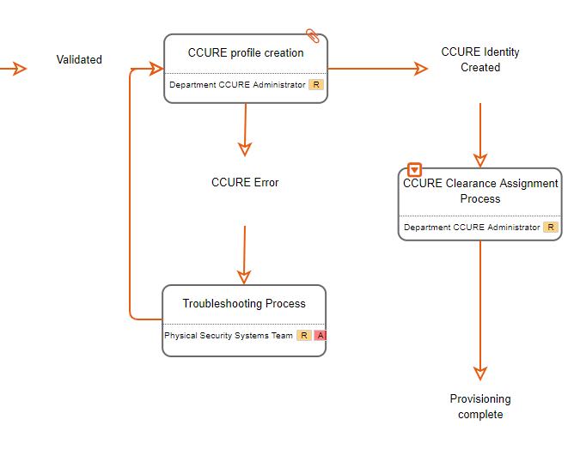
Process Delivery
Layered Content
Strategic
Tactical
Task
Content Management
Consolidated Location
Version Control
Educated Team
Process Tools
Requirements Based
Good experience
Skillset Appropriate

Slide 15
Security Plan
Governance

Slide 16
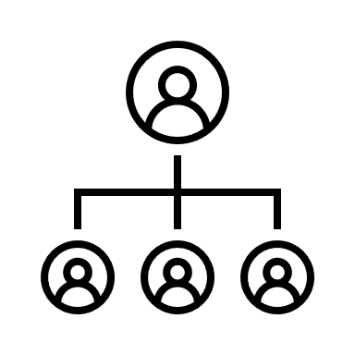
Governance
Siloed groups into a collaborative organization
Documented roles and responsibilities
Communication best practices
Security’s seat in the C-Suite
Role appropriated task management
Siloed Groups
Roles
Responsibilities
Communication
Leadership Alignment
Operational Alignment
Unified Message

Slide 17
Security Plan
Awareness

Slide 18
Awareness
Formalize the plan
Target audience
Behavior Types
Messaging
Timing
Engage with users
Develop partnerships
Recruit executive sponsors
Establish culture of safety, not surveillance
Content Delivery
Traditional
Digital media
Social media
Aligned Culture
Formal Process
Smart Content
Regular Outreach

Slide 19
Security Plan
Training

Slide 20
Training
Customize to the audience
Not all risks apply to every audience
Engage with users
Town halls
Social and digital media
Newsletters
Social events
Create a feedback and refresh loop
Use traditional and modern tools
Apps
Messages & notifications
Events and programs
Fire Training
Risk and Audience Focused
Existing Opportunities
Security’s Role to Promote Safety
Social Engagement

Slide 21
Security Plan
Technology

Slide 22
Technology
What are my risks?
Can my existing portfolio mitigate those risks?
What is my risk tolerance?
What are my peers doing?
Will it work in my environment?
How do I responsibly deploy it?
Develop functional requirements
Understand current state
Leverage existing systems and parallel efforts
Align with business and technical roadmaps
Understand market trends, eliminate noise
Evaluate and validate new technologies
Establish a short and long term roadmap

Slide 23
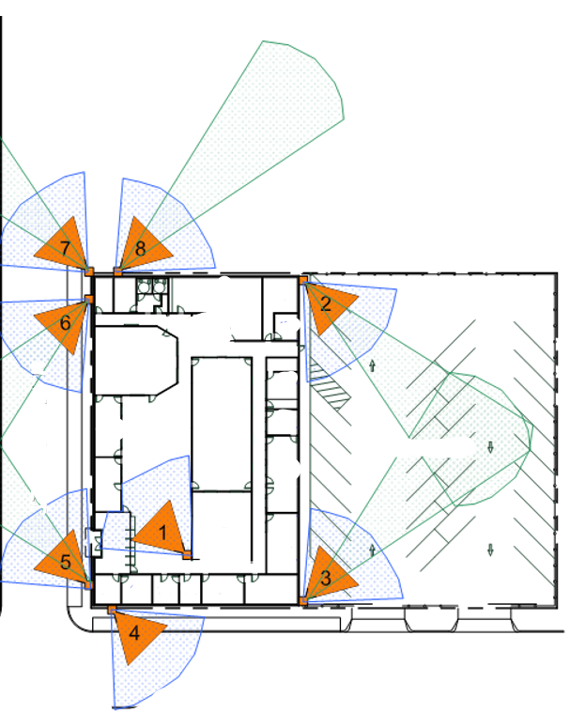
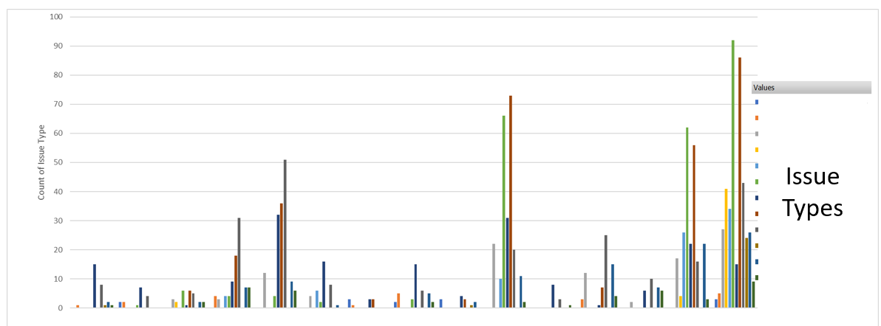
Technology: Visualize Your Current State

Slide 24
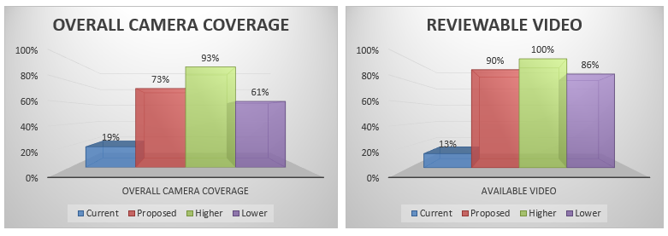
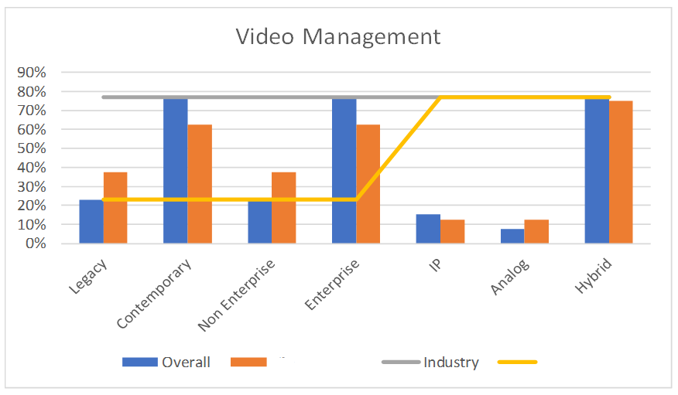
Gap Analysis: Data Driven Business Case

Slide 25
Future State: Informed Deployment Plan
Year 1
Year 2
Year 3
Year 4
Year 5

Slide 26
Technology Trends to Watch For
Trends
Frictionlness
Mobile
Cloud
Identity and access management
Health and wellness
Consumer Trends
Truth About Privacy
User Experience

Slide 27
Security Plan
Life Cycle Management

Slide 28
Life Cycle Management
Importance
Awareness of current state
Proactive planning of future state
Funding and administrative roadmap
Elements
Technology
Maintenance
Useful life of technology
Licenses
Policies
Funding pipeline
Current Practice
Future State
Mission critical
Excel
Facilities management
Inventory management
Discoverable assets

Slide 29
Concluding Narrative
Establish current state understanding and create a life cycle plan
Develop and document a strategic security plan
Communicate with leadership and seek sponsorship
Build partnerships to leverage existing initiatives and technologies

Slide 30
Concluding Narrative
Current State
Functional Requirements
Gap Analysis
Roadmap
Executive Sponsorship
Future State

Slide 31
Q&A

